Slide 1
ICS ACTIVE LEARNING
List and state briefly security testing tools.
Presented By:
PC-44 Tejas Redkar
PC-49 Gayatrini Neogi PC-50 Atharva Chaher PC-63 Jinal Gulhane

Slide 2
ACKNOWLEDGEMENT
We deeply appreciate Dr. Uma Pujeri's invaluable contributions to the field of Information and Communication Systems (ICS). Her expertise, dedication, and guidance have been instrumental in shaping our understanding of ICS. We are grateful for her unwavering support and knowledge, which have enriched our learning experience and empowered us to delve deeper into this dynamic field. Dr. Uma Pujeri is a luminary in the realm of ICS, and her impact is profound.

Slide 3
Topics to be Covered
Introduction to Security Testing Tools
NetSparker
ImmuniWeb
Vega
Wapiti
Google Nogotofail
Acunetix
W3af
SQLMap
Conclusion

Slide 4
Introduction
From mini eateries to big-box retailers, from small organizations to federal bodies, cyber attackers are eyeing every small opportunity to steal valuable data on Personality Identifiable Information (PII).
Whether it’s Facebook or Equifax, a single vulnerability, a tiny flaw in the security system, has caused them to lose both revenues and reputation.
If security incidents like these have taught us anything, it is that web security cannot be taken lightly, and even the best of us are not safe from it.
Web security testing tools are useful in proactively detecting application vulnerabilities and safeguarding websites against malicious attacks.

Slide 5

1. NetSparker
Automatic, accurate and easy-to-use web application security scanner .
NetSparker acts as a one-stop shop for all the web security needs.
Available as both a hosted as well as self-hosted solution.
NetSparker has a trademarked Proof-Based-Scanning technology that uses automation to identify vulnerabilities and verify false positives.

Slide 6

2. Google Nogotofail
It is a network traffic security testing tool.
Nogotofail provides a flexible and scalable way of scanning, identifying, and fixing weak SSL/TLS connections.
It checks whether they are vulnerable to man-in-the-middle (MiTM) attacks.
It can be set up as a router, VPN server, or proxy server

Slide 7

3. ImmuniWeb
ImmuniWeb is a next-gen platform that employs Artificial Intelligence to enable security testing.
This AI-enabled penetration testing platform offers a holistic benefits package for security teams, developers, CISOs, as well as CIOs.
Having a one-click virtual patching system, this platform assists in continuous compliance monitoring.
It boasts a proprietary Multilayer Application Security Testing technology and checks a website for compliance, server hardening, and privacy.

Slide 8

4. Vega
It is a free, open-source vulnerability scanning and testing tool written in Java.
Vega is GUI-enabled and works with OS X, Linux, and Windows platforms. It’s an automated scanner powered by a website crawler that facilitates quick tests.
The intercepting proxy aids tactical inspection by observing and monitoring client-server communication.
Vega can detect web application vulnerabilities like blind SQL injection, shell injection, reflected and stored cross-site scripting, etc.
Its detection modules are written in JavaScript and can be used to create new attack modules as and when required with APIs.

Slide 9

5. Wapiti
Wapiti is a command-line application that crawls through webpages to detect such scripts and forms where data can be injected.
It performs a black box scan and injects payloads in the detected scripts to check for vulnerability.
With support for both GET and POST HTTP attack methods, this tool generates vulnerability reports in various formats and features different verbosity levels.
It detects vulnerabilities like file disclosure, database injection, file inclusion, cross-site scripting (XSS), weak .htaccess configuration, etc.
It can differentiate between permanent and reflected XSS vulnerabilities and raises warnings whenever an anomaly is found.

Slide 10
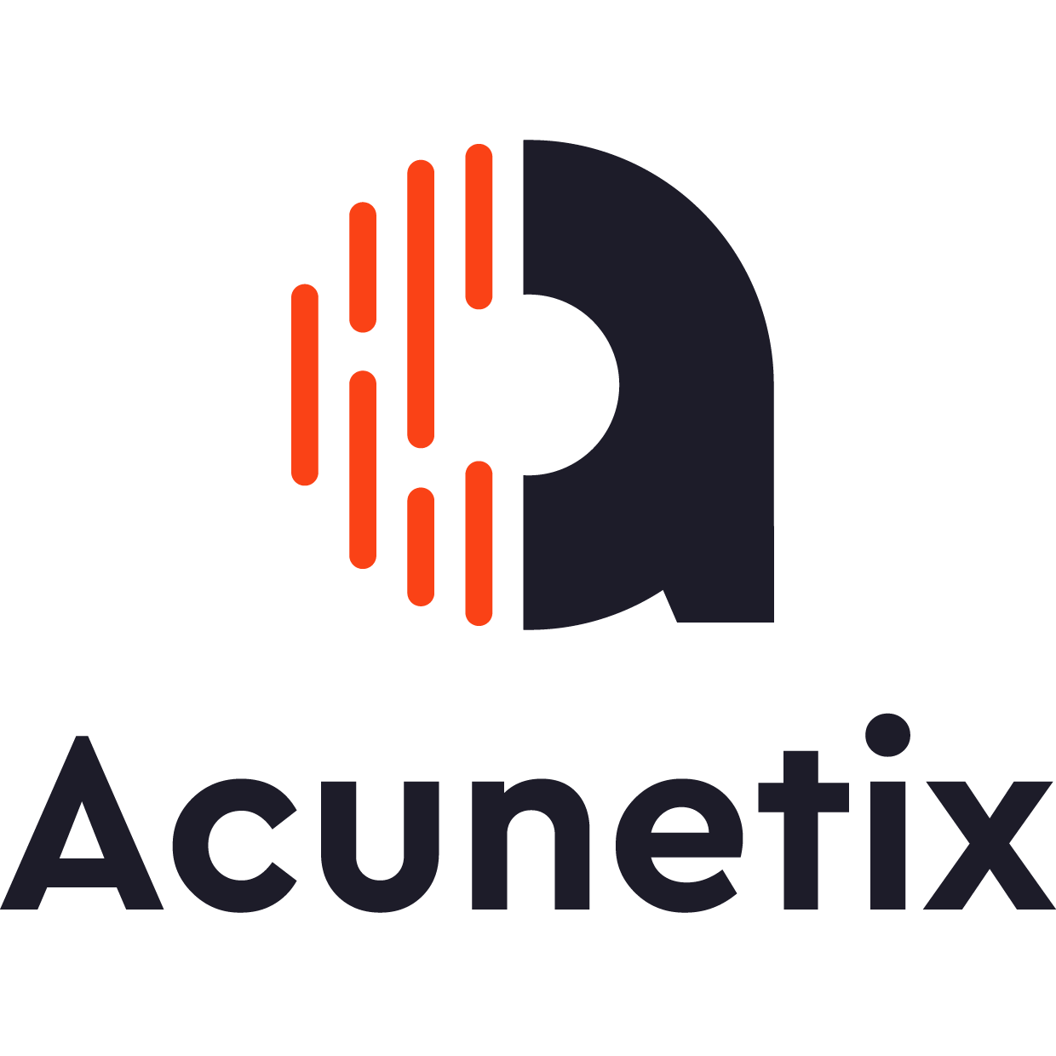
6. Acunetix
Acunetix, with its vulnerability scanner, pioneered automated web application security testing.
The Acunetix Vulnerability Scanner features innovative black-box scanning and SPA crawling techniques in the form of AcuSensor and DeepScan.
The multi-threaded, DeepScan crawler has the capability to run an uninterrupted scan of WordPress installation for over a thousand vulnerabilities.
A Login Sequence Recorder enables the tool to scan password-protected fields, whereas an in-built vulnerability management system helps generate various technical and compliance reports.

Slide 11

7. W3af
It is a web application audit and attack framework that is effective against over 200 vulnerabilities.
By identifying vulnerabilities such as SQL Injection, Cross-site scripting, Guessable credentials, unhandled application errors, and PHP misconfigurations, it assists in limiting the total exposure of a website to malicious elements.
With both graphical and console-based interfaces, W3af promises the possibility of auditing a web app’s security in less than five clicks.
It can be used to send HTTP requests and cluster HTTP responses. If a website is protected, it can use authentication modules to scan them. Output can be logged into a console, a file, or sent via email.

Slide 12

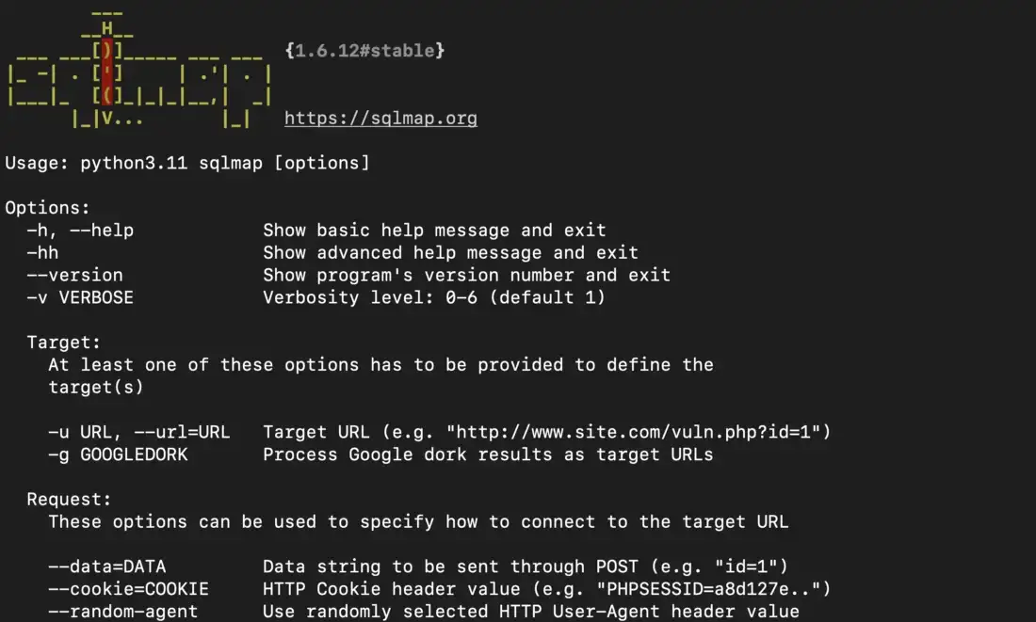
8. SQLMap
SQLMap is a penetration testing tool powered by a detection engine for automating the identification and exploitation of SQL injection flaws.
Encompassing support for a broad spectrum of database management systems and SQL injection techniques, SQLMap automatically recognizes hash-based passwords and supports orchestrating a dictionary-based attack to crack them.
With seven levels of verbosity support, it offers ETA support for each query and brings granularity and flexibility for both users’ switches and features. Its fingerprint and enumeration features are valuable in streamlining an effective penetration test run.

Slide 13
Conclusion
Therefore, we have seen several tools that are used to test a website for various errors and security breaches. These security testing tools helps us in making sure that we have a strong website which would stand attacks from hackers.

Slide 14
Thank You!!

